Slide 1



PROJECT ON
Exploratory Data Analysis of the Used Car Resale Market
Presented by: M. Chandra kiran
BATCH No: 450
Subject: EDA

Slide 2
About Me
I am MEKALA CHANDRA KIRAN
I Recently Completed my graduation in the stream of Computer Science and Engineering from Teegala Krishna Reddy Engineering College, Hyderabad
LinkedIn : https://www.linkedin.com/in/mekala-chandra-kiran-6a2136389/
Git hub : https://github.com/mekalachandrakiran123

Slide 3
Agenda
Problem Statement
Objective
Dataset Overview
Univariate Analysis
Bi-variate Analysis
Multi variate Analysis
Hypothesis Testing
Applications
Conclusion

Slide 4
Problem Statement
The used car market is highly dynamic and varies significantly across brands, models, and vehicle attributes such as fuel type, transmission, age, and kilometers driven. Customers looking to buy a second-hand car often struggle to identify fair prices and compare options across brands, while vendors face difficulties in pricing their vehicles competitively due to a lack of market transparency. As a digital used-car marketplace, hosts large volumes of listings, but the data is not readily available in an analytical format for deriving actionable insights.

Slide 5
Objective
The main objective of this project is to collect used car data from the website and analyze it to help people make better decisions when buying or selling second-hand cars.
Through this project, we aim to:
Collect used car details such as price, brand, model, year, fuel type, transmission, and kilometers driven.
Understand how used car prices vary from brand to brand.
Identify which car brands and models has highest demand in the used market.
Analyze how factors like kilometers driven, fuel type, transmission, and usage affect the car price.
Provide clear insights that help buyers find affordable cars and sellers price their cars correctly.

Slide 6
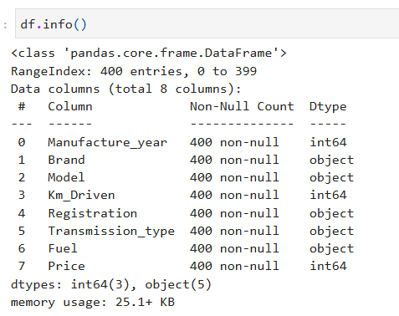
Dataset Overview
Observation:
1.The Data Frame contains 400 rows, indexed from 0 to 399
2. There are 8 columns: Manufacture year, brand, model,
km driven, Transmission type, fuel, price etc…
3.No Missing data, All 400 entries in each column are
non-null, indicating no missing values in the dataset.
Data Extraction:
1.Identified relevant data fields such as car brand, model, price, fuel type, kilometers driven, and manufacture year from the website.
2.Used Python libraries like Requests and Selenium to scrape listing data from web pages.
3.Extracted raw HTML elements and parsed them into structured tabular format using pandas.
4.Stored the extracted data in CSV format for further cleaning, analysis, and visualization.

Slide 7
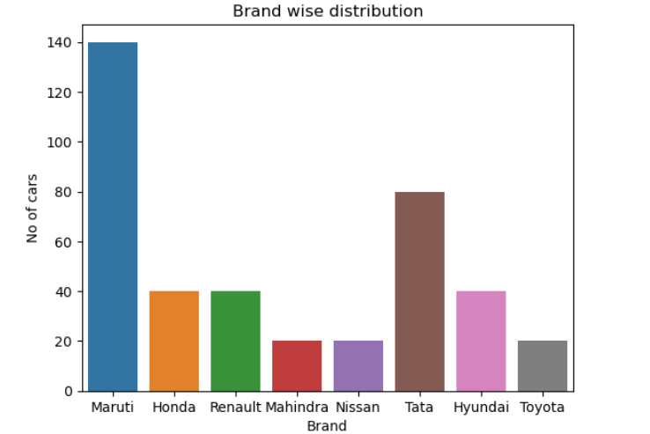
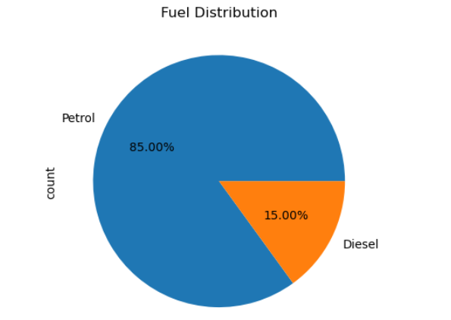
Univariate Analysis
Insight:
“The visualization highlights brand-wise supply distribution in the used-car market. Maruti dominates listings, indicating high resale activity, while brands like Toyota and Nissan show limited availability, suggesting potential scarcity-driven pricing. Easier for buyers to find Maruti cars at competitive prices”
Insight:
“The fuel-type distribution shows that petrol cars dominate the used-car listings, accounting for 85% of the supply. Diesel cars form a smaller segment, indicating changing market preferences and the impact of emission regulations. Buyers have more options and better price negotiation in petrol cars.”

Slide 8
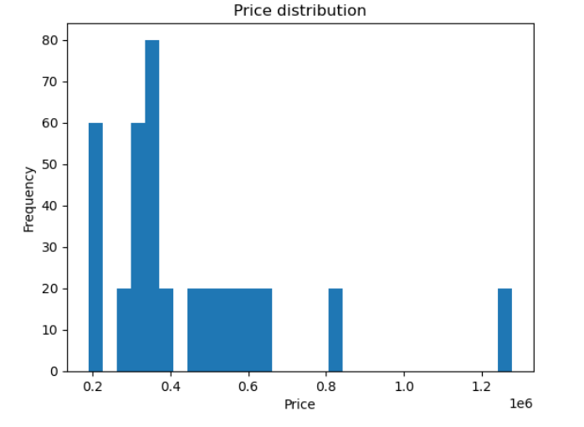
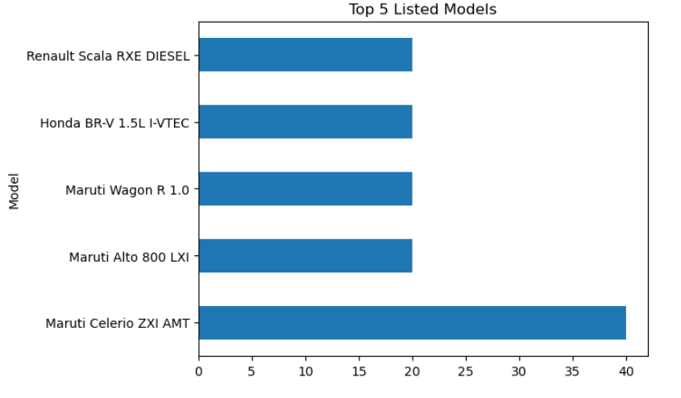
Insight:
The price distribution of used cars is positively skewed, with most listings concentrated in the ₹2–4 lakh range. A small number of high-priced vehicles create outliers, reinforcing the use of median price for accurate market analysis. Few cars priced above ₹8–12 lakhs. These are likely: Premium brands, Newer models, Low km driven vehicles”

Slide 9
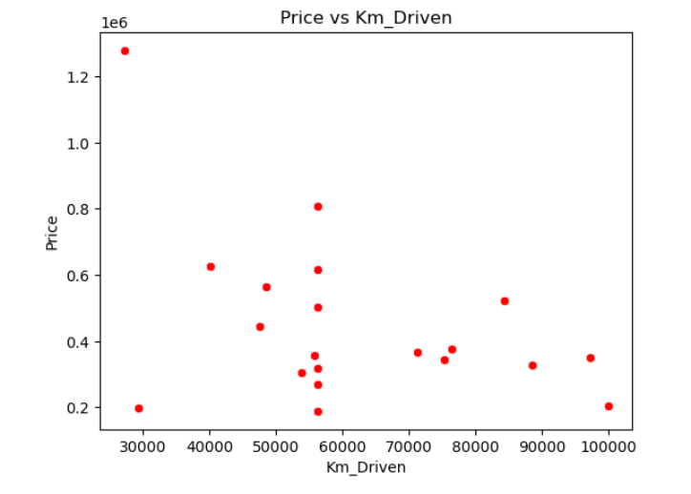
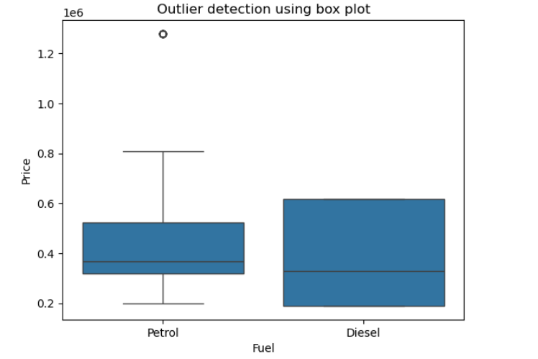
Bi-variate Analysis
Insight:
“The scatter plot reveals a negative correlation between kilometers driven and resale price. While price generally decreases with higher usage, mileage levels highlights the importance of brand, model, and vehicle condition. As kilometers driven increase, price generally decreases. Clear evidence of car depreciation with usage”
Insight:
“The boxplot reveals a right-skewed price distribution with a few high-price outliers. Since these extreme values can bias the mean, the median price is a more reliable metric for understanding the typical used-car price. One or more cars priced around ₹12–13 lakhs lie outside the upper whisker. These are statistical outliers”

Slide 10
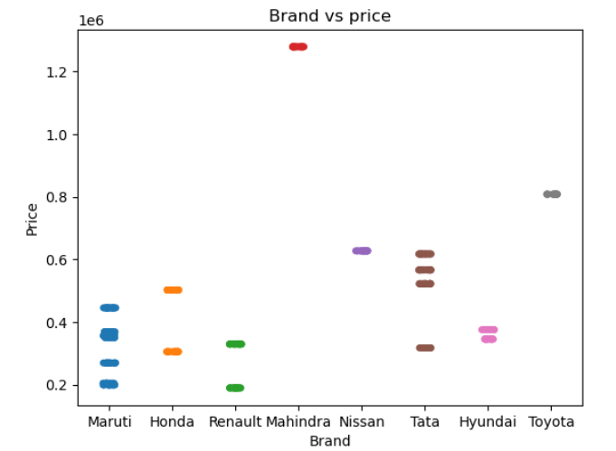
Insight:
“The brand-wise price distribution shows clear market segmentation, with premium brands like Toyota and Mahindra commanding higher resale prices, while mass-market brands such as Maruti and Renault dominate the lower price segment.”

Slide 11
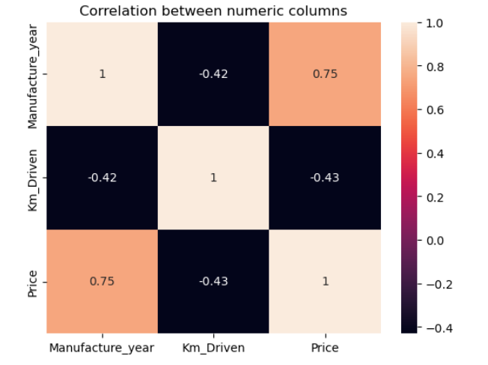
Multi-Variate Analysis
Insight:
“The correlation analysis shows that manufacture year has a strong positive relationship with price, while kilometers driven has a moderate negative impact. This indicates that car age plays a more critical role in used-car valuation.”

Slide 12
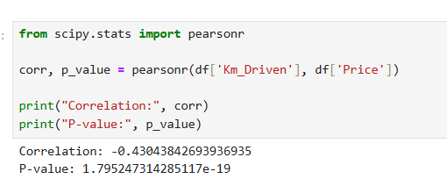
Hypothesis Testing
Hypothesis testing helps us to:
1. Validate assumptions with statistical evidence
2. Avoid decisions based only on visual trends
3. Provide confidence-backed insights
1. Is Km Driven related to price?
🔹 Hypothesis
H₀: Km Driven has no impact on car price
H₁: Km Driven significantly impacts car price
🔹 Test Used
✅ Pearson Correlation Test

Slide 13
Decision Rule
If p < 0.05 → Reject H₀
If p ≥ 0.05 → Fail to reject H₀
Insight:
Strong negative correlation → depreciation is a key pricing factor. “There is a statistically significant negative relationship between Km Driven and resale price, confirming that depreciation plays a major role in used-car pricing.”

Slide 14
Applications
This project has several practical applications for different stakeholders in the used car ecosystem. For used car buyers, the analysis helps in comparing prices across multiple brands and identifying models that offer better value for money. It enables buyers to understand how factors such as fuel type, transmission, car age, and kilometers driven influence prices, thereby supporting more informed purchasing decisions. For sellers, the project provides insights into current market pricing trends, helping them set competitive and realistic prices for their vehicles based on demand and vehicle attributes. From a platform perspective, we can use these insights to improve price benchmarking, optimize inventory planning, and design targeted marketing strategies.

Slide 15
Conclusion
In this project, used car data was collected from the website using web scraping techniques and transformed into a structured dataset for analysis.
The analysis showed that used car prices vary significantly based on kilometers driven, even within the same brand and model.
Key factors such as car age, fuel type, transmission, and usage strongly influence vehicle pricing.
Newer cars and automatic transmission vehicles generally command higher resale values.
Popular brands and models were identified, revealing demand patterns and resale trends in the market.
Overall, the project demonstrates how web scraping and data analysis can generate valuable, data-driven insights for the used car industry.

Slide 16


Slide 17

THANK YOU

